Slide 1
Distributed Availability Groups
Raghu Gopalakrishnan
Microsoft PFE

Slide 2

Agenda
AlwaysOn Availability Groups Basics
Data Replication between nodes
Distributed Availability Groups
Introduction
Setup Demo
Use Cases

Slide 3
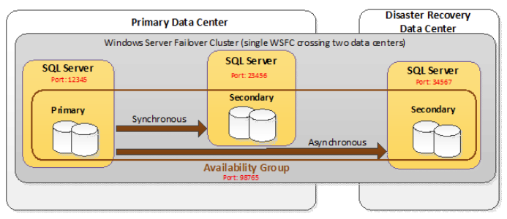
AlwaysOn Availability Groups (Traditional)
Notes:
https://blogs.msdn.microsoft.com/sqlcat/2014/02/03/alwayson-availability-groups-listener-named-instances-port-numbers-etc/

Slide 4
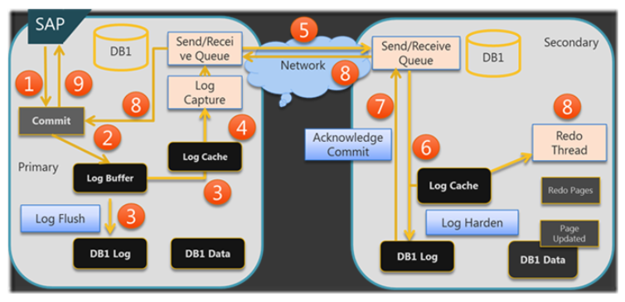
Data Replication Between Nodes
Notes:
Step 1: In a typical case the SAP application would send a commit to finalize a transaction
Step2: The commit record is inserted into the actual log buffer.
Step 3: The commit record triggers a flush of the log buffer to persist the buffer in the transaction log on the instance running the primary replica. In the same notion the buffer is copied into the new log cache. If all secondary replicas are in an asynchronous availability mode, the success of this step would be good enough to send an acknowledge message of a successful commit back to the application when the I/O to the local transaction log successfully executed.
Step 4: The new log capture framework will now capture the new log data and will hand it over into our messaging framework which will manage the send and receive queues as well as failure detection in the network traffic.
Step 5: The change records as persisted to the transaction log of the primary are getting transferred to the instances in the secondary role. The log content is getting compressed and encrypted before sending it over the instances running the secondary replicas.
Step 6: The content received from the messaging framework gets persisted in the transaction log of the secondary replicas and at the same time get inserted into the log cache of the secondary replicas.
Step 7: The moment the content was successfully persisted in the transaction log of the secondary instance an acknowledge message is sent to the messaging framework
Step 8: As the acknowledge messages of the successful persist on the secondary replica is sent to the primary replica, the secondary replica is starting to apply the changes to the actual data pages. If all the acknowledges of the synchronous secondary replicas is received on the instance running the primary replica the next step can be done
Step 9: The acknowledge message is sent to the SAP application
I think this is enough for a first rough explanation of AlwaysOn. As you likely realized, there was no mentioning of a Witness as we had it in Database Mirroring. The next part of the series will explain why we don’t need a witness instance anymore and how it is getting substituted.
Reference: https://blogs.msdn.microsoft.com/saponsqlserver/2012/02/07/sql-server-2012-alwayson-what-is-it/

Slide 5
Distributed Availability Groups
Started with SQL Server 2016
1
A traditional availability group has resources configured in a WSFC cluster. A distributed availability group does not configure anything in the WSFC cluster. Everything about it is maintained within SQL Server.
2
A distributed availability group requires that the underlying availability groups have a listener.
3
The only way to make AG 2's primary replica accept inserts, updates, and deletions is to manually fail over the distributed availability group from AG 1.
4
Only manual failover is supported for a distributed availability group.
5

Slide 6
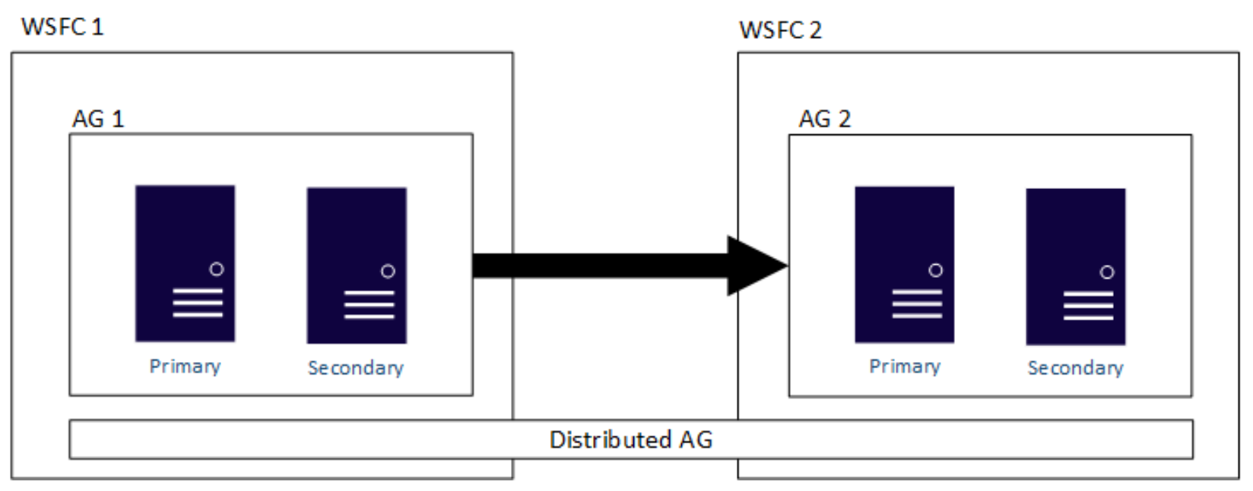
Distributed Availability Group
Notes:
Reference:
https://docs.microsoft.com/en-us/sql/database-engine/availability-groups/windows/distributed-availability-groups?view=sql-server-2017

Slide 7
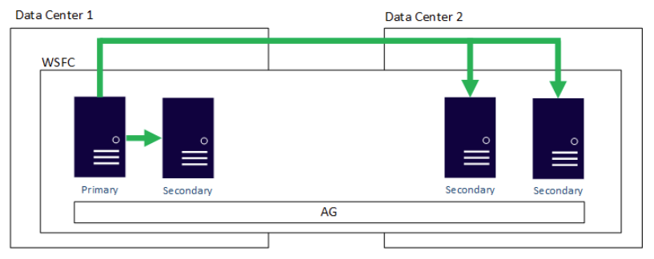
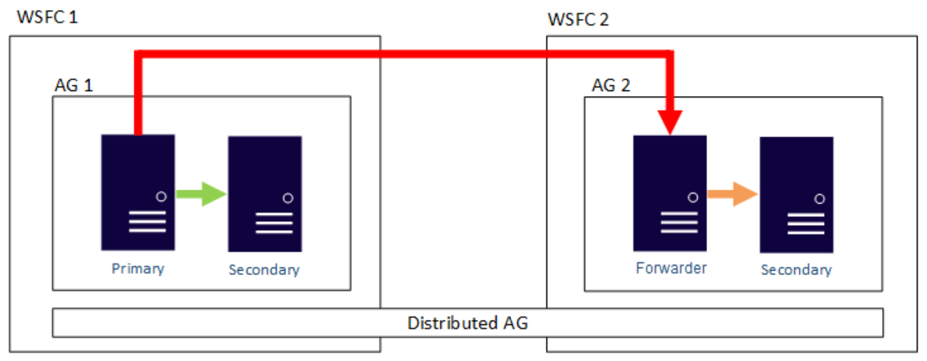
Traditional AG vs Distributed AG
Notes:
Reference:
https://docs.microsoft.com/en-us/sql/database-engine/availability-groups/windows/distributed-availability-groups?view=sql-server-2017

Slide 8
Configure Distributed Availability Groups
Create
Create 1st Availability Group
Create
Create 2nd Availability Group
Create
Create distributed availability group on first cluster
Join
Join distributed availability group on second cluster
Fail over
Fail over to a secondary availability group
Remove
Remove a distributed availability group

Slide 9

Demo

Slide 10
Distributed availability group use cases
Disaster recovery and easier multi-site configurations
Migration to new hardware or configurations, which might include using new hardware or changing the underlying operating systems
Increasing the number of readable replicas beyond eight in a single availability group by spanning multiple availability groups

Slide 11
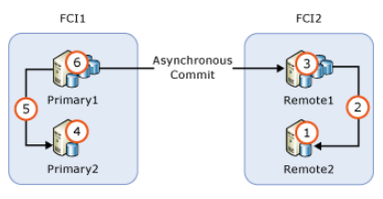
Patch Installation
Because there are two separate availability groups, the process of installing a service pack or cumulative update on a replica that's participating in a distributed availability group is slightly different from that of a traditional availability group
Notes:
https://docs.microsoft.com/en-us/sql/database-engine/availability-groups/windows/upgrading-always-on-availability-group-replica-instances?view=sql-server-2017

Slide 12
Upgrade/Migrations
Stop all data traffic to the original availability group and change the distributed availability group to synchronous data movement.
1
This action ensures that the primary replica of the second availability group is fully synchronized, so there would be no data loss.
2
Fail over the distributed availability group to the secondary availability group.
3
1. Rename the listener on the secondary availability group (and possibly delete or rename the old one on the original primary availability group) Or re-create it with the listener from the original primary availability group, so that applications and users can access the new configuration.
2. If a rename or re-creation is not possible, point applications and users to the listener on the second availability group.
4

Slide 13
Thank you!

